Slide 1


Support Guide for Searching in the Workshop Equipment Database
GSP
08/2013

Slide 2
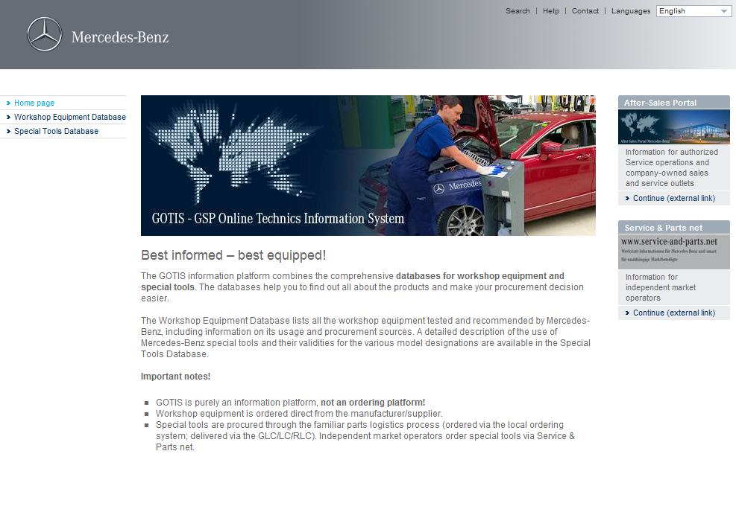
GOTIS homepage
The GOTIS homepage provides general information about the platform as well as about workshop equipment and Mercedes-Benz special tools.
Please note that GOTIS is not an ordering platform.

Slide 3
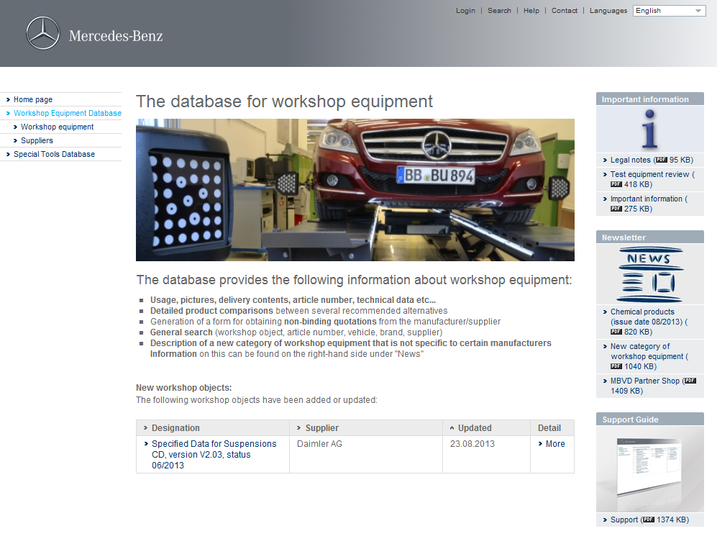
Information on new workshop objects
Direct access to the five newest workshop equipment objects

Slide 4
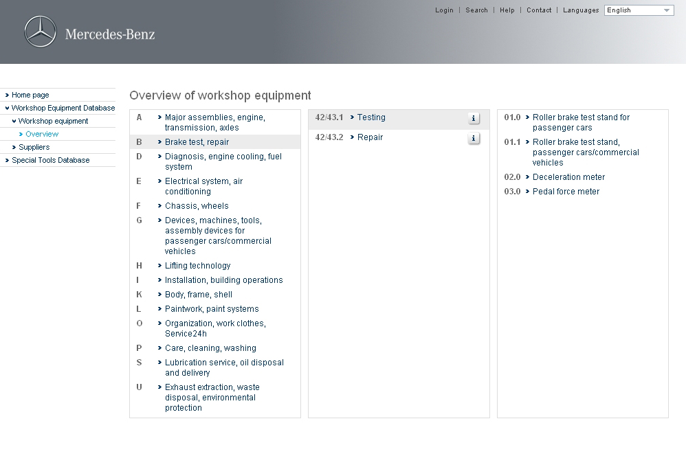
Searching for workshop equipment
In the "Overview of workshop equipment", you can search for workshop equipment by Chapter, Function Group and Product Topic.
The i-Button contains important information about the respective topic.
Chapter
Function groups
Product topics

Slide 5
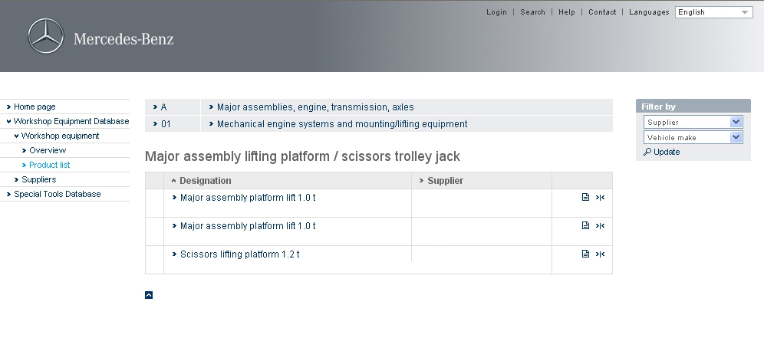
Product list
The detailed view is accessed here. This provides you with an overview of applications and procurement sources.
Add to watchlist
Here you can sort products by supplier and/or vehicle make.
Add to product comparison

Slide 6
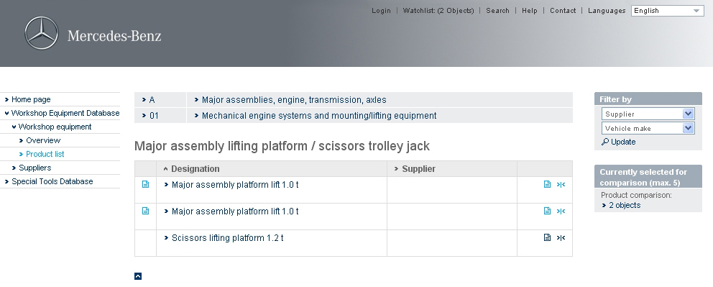
Product comparison
This field then gives you an overview of the number of products previously selected for comparison. You can view a comparison of the selected products by clicking on the word "Objects".
The selected products are saved for comparison by clicking on the comparison symbol.

Slide 7
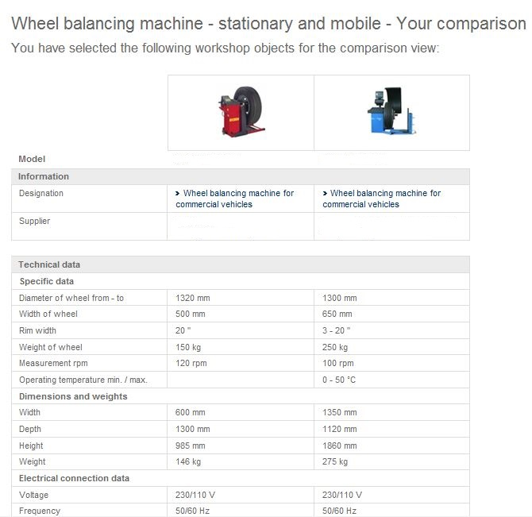
Product comparison
This example of a product comparison shows two wheel balancing machines.
The detailed view is accessed here.

Slide 8
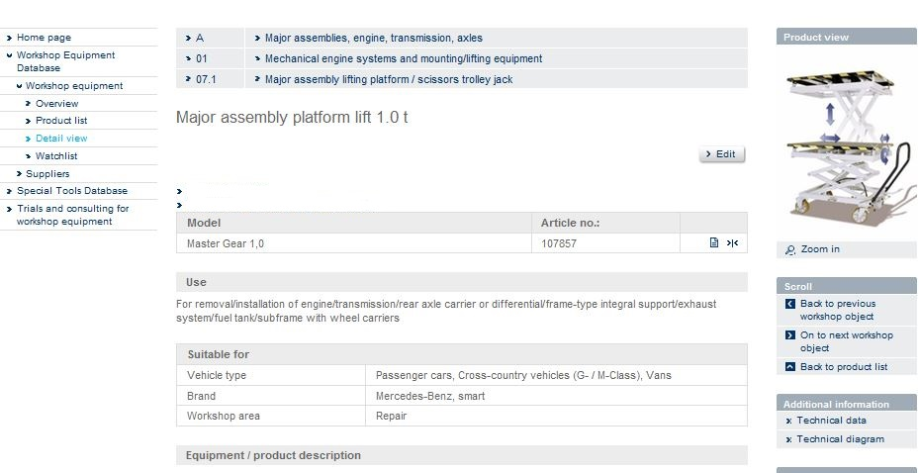
Detailed view of a selected product
Pay attention to the "Additional information" box.
Other documents on the workshop object can be found here.

Slide 9
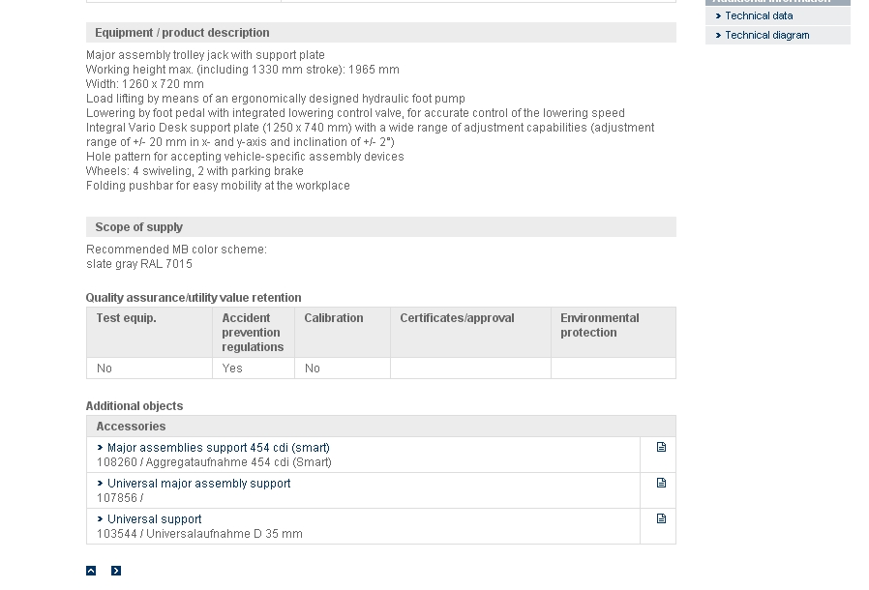
Detailed view of a selected product
Here you can see a list of additional workshop equipment objects e.g. accessories and alternatives.

Slide 10
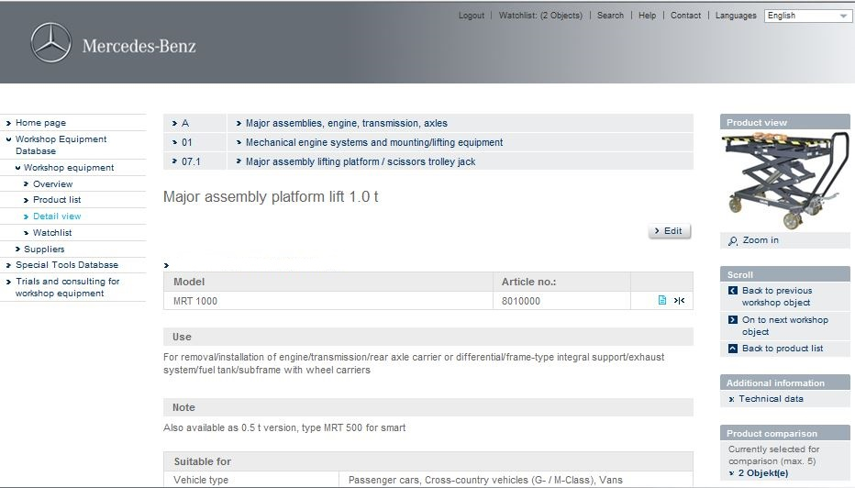
Adding products to the watchlist
Clicking on "Watchlist" displays an overview of the products you have selected. You can subsequently create a form to request a quotation.
Add your product to the watchlist

Slide 11
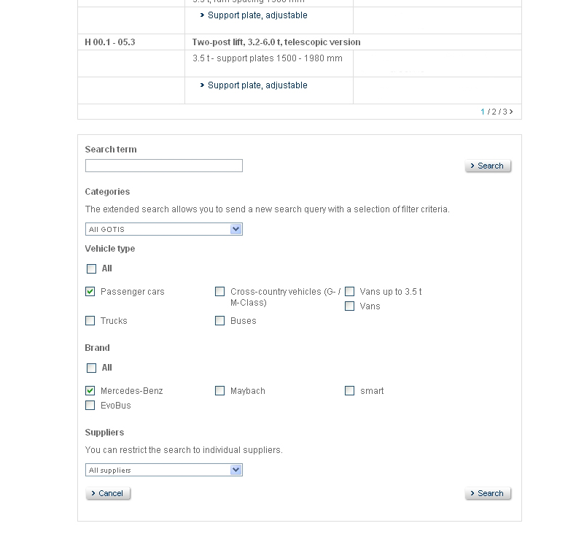
Search function for workshop objects
You can also specify your search by "Vehicle type" and "Brand".

Slide 12
Contact
If you have any further questions about the GOTIS information platform or its products, please contact the following e-mail address:
gotis.kontakt@daimler.com

Slide 13
声明：
所有的版权属于原有公司，文件均来自公开渠道
此文件仅供学习使用，任何人不得进行以此为商业目的的行为
如有疑问，请立即删除
学习世界五百强和咨询公司PPT课程请访问如下网站搜索：“司马懿”
百度传课：司马懿PPT学校
https://www.chuanke.com
网易学堂：司马懿PPT学校
https://study.163.com
知乎： 司马懿PPT学校
https://www.zhiu.com

